Slide 1

DIGITAL
PORTFOLIO
STUDENT NAME: Elakkiya. G
REGISTER NO AND NMID: 222402611, asunm161222402611
DEPARTMENT: Computer Science with Data Science
COLLEGE: Prince Shri Venkateshwara Arts & Science College/Madras University

Slide 2
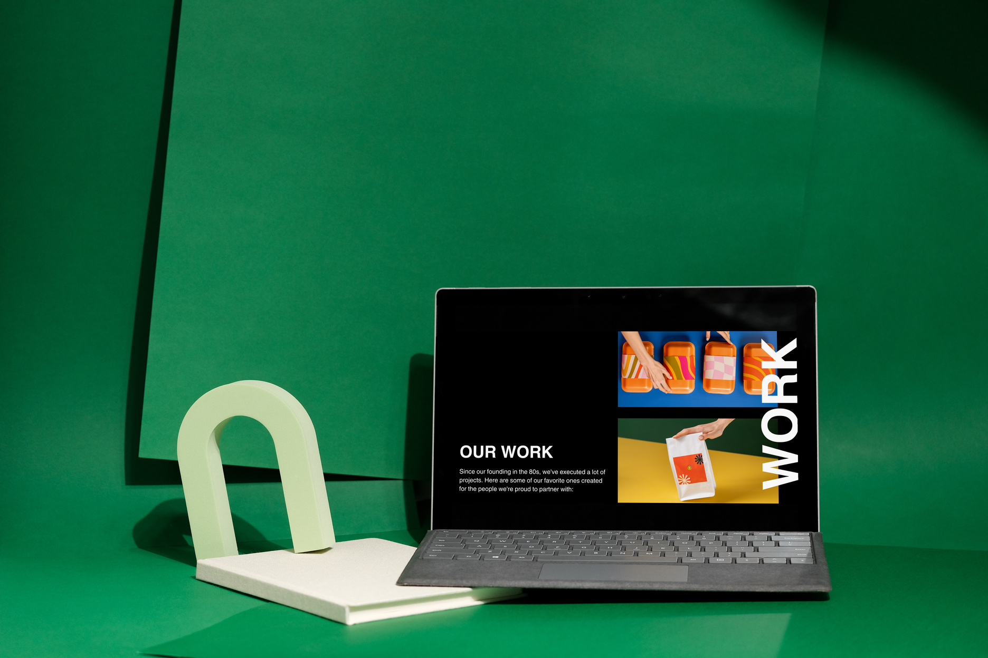
CREATIVE PROFILE WEBSITE

Slide 3
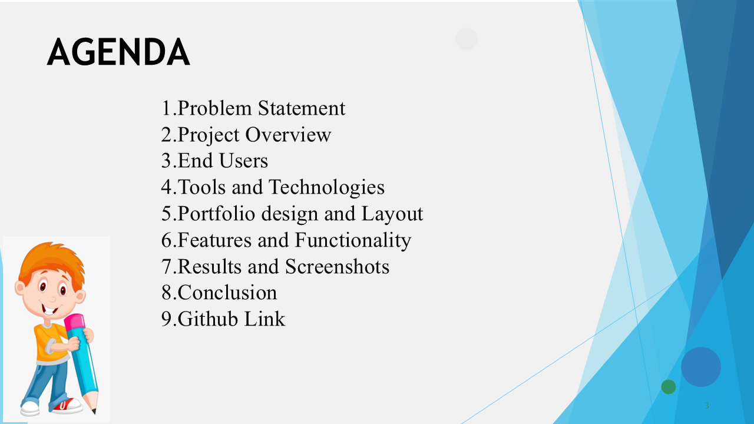

Slide 4
PROBLEM STATEMENT
Resumes in PDF or paper formats are static.
They are difficult to update frequently with new skills.
Sharing updated versions with recruiters becomes time-consuming.
A digital portfolio allows instant updates and easy sharing.

Slide 5
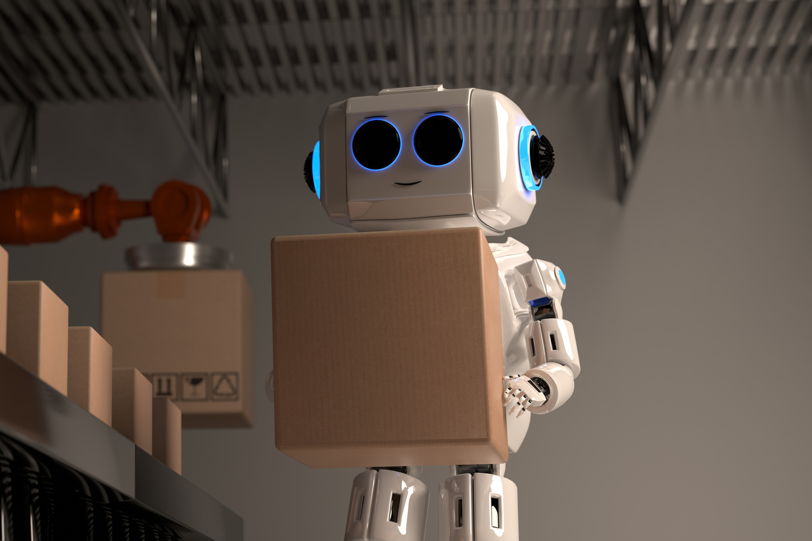
PROJECT OVERVIEW
A visually appealing portfolio website that balances academics and creativity. It includes sections like About Me, Skills, Hobbies, Education, and Contact, with my profile image as a centerpiece to make it more personalized.

Slide 6
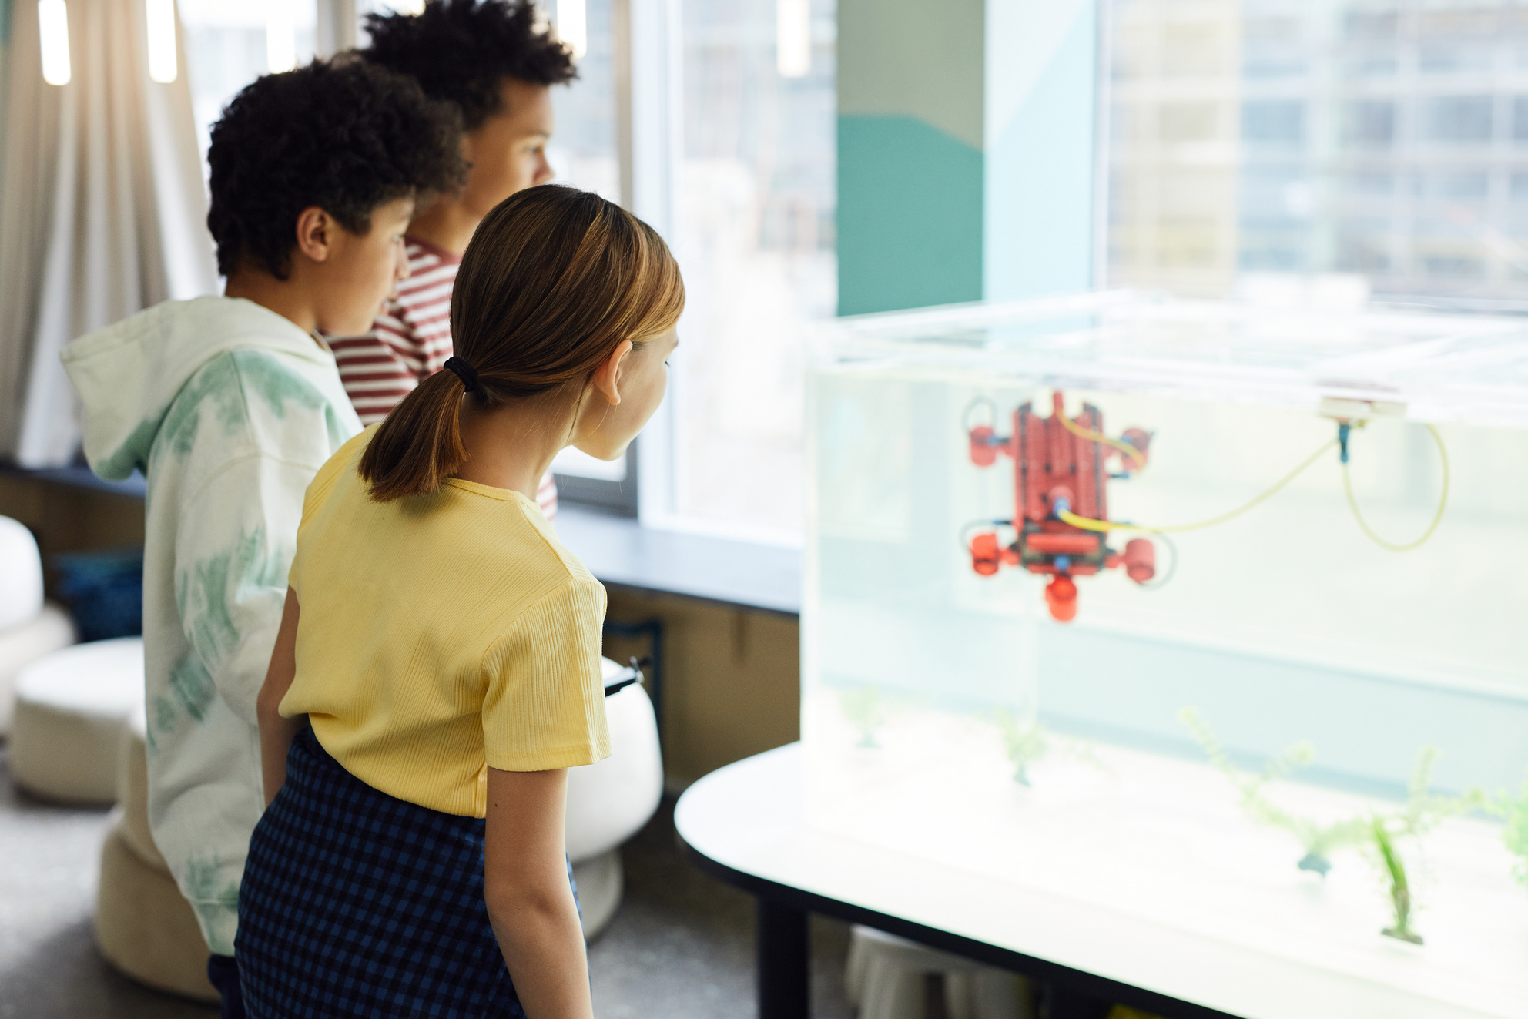
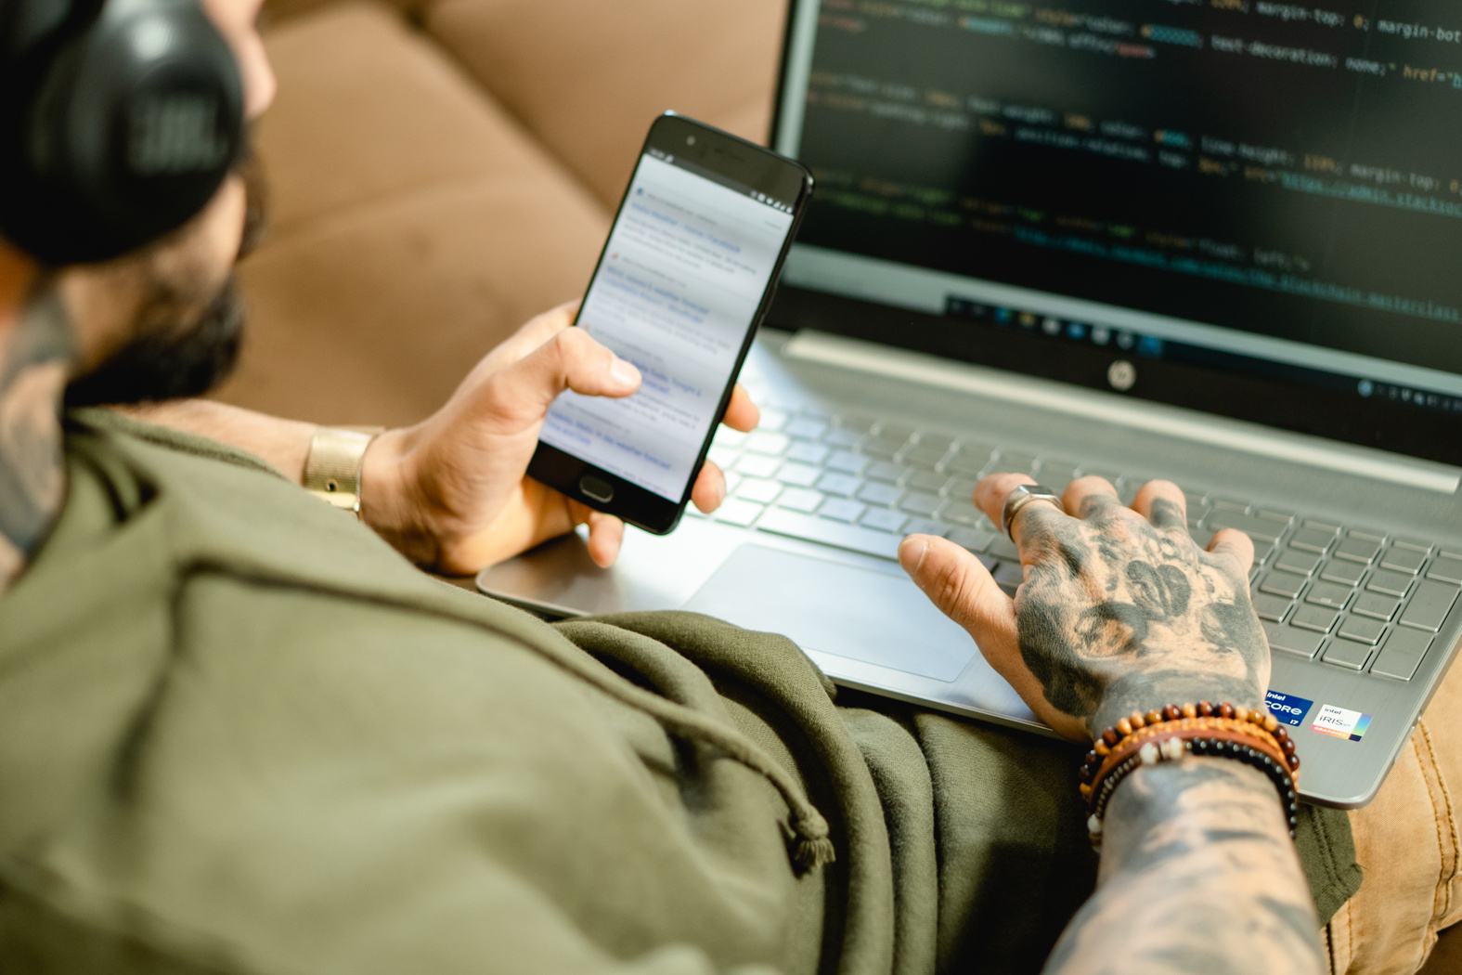
END USERS
Students (showcasing projects & skills).
Recruiters (evaluating both technical and creative strengths).
Peers/Collaborators (networking opportunities).
Educators (assessing academic and personal growth).

Slide 7
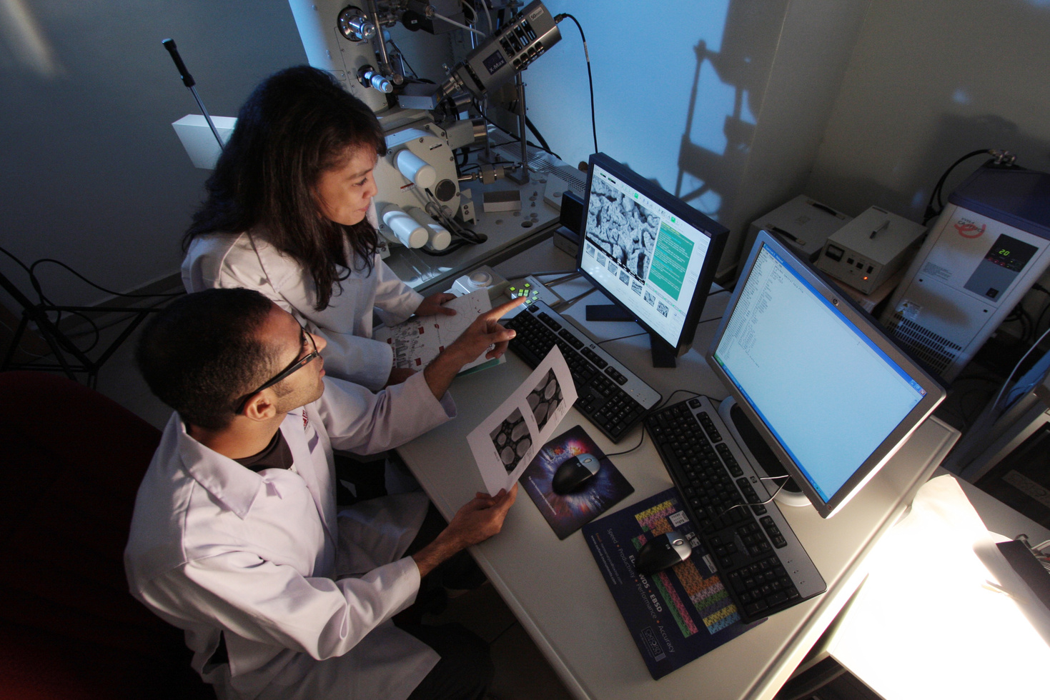
TOOLS AND TECHNIQUES
Frontend: HTML, CSS, Tailwind CSS
Scripting: JavaScript
Design Tools: Canva, Photoshop, DaVinci Resolve, Alight Motion
Icons/Fonts: Font Awesome, Google Fonts (Inter)

Slide 8

POTFOLIO DESIGN AND LAYOUT
Hero Section → Profile image + tagline.
About Me → Personal introduction & career goals.
Skills → Programming + Designing skills.
Education → Class 10th & Class 12th qualifications.
Contact/Footer → Copyright + links.
Special Effects → Starry background + rainbow cursor animation.

Slide 9
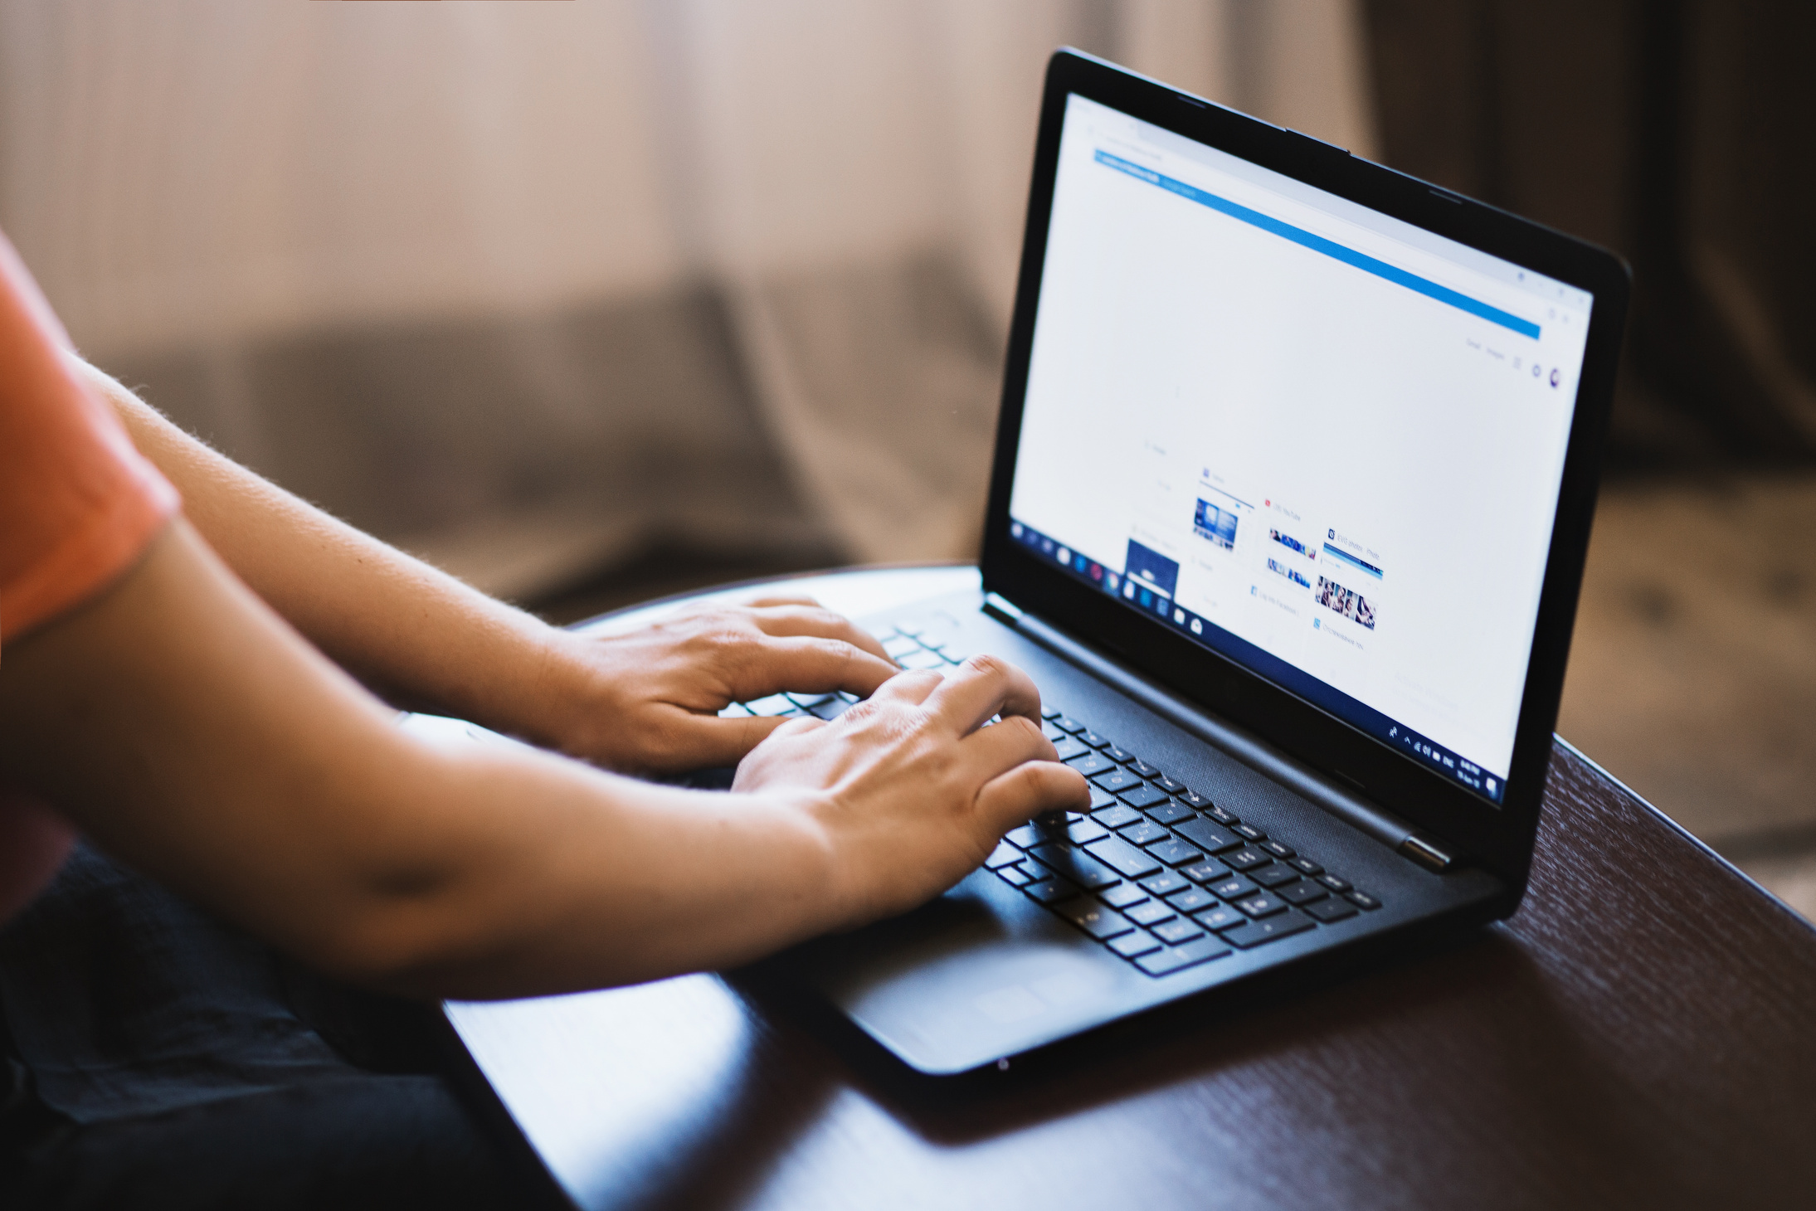
FEATURES AND FUNCTIONALITY
Responsive design (works on all devices).
Interactive animations (hover effects, cursor trail).
Personalized UI with profile image & dark theme.
Skills split into Programming and Designing.
Creative visuals with hover scaling and glowing effects.

Slide 10
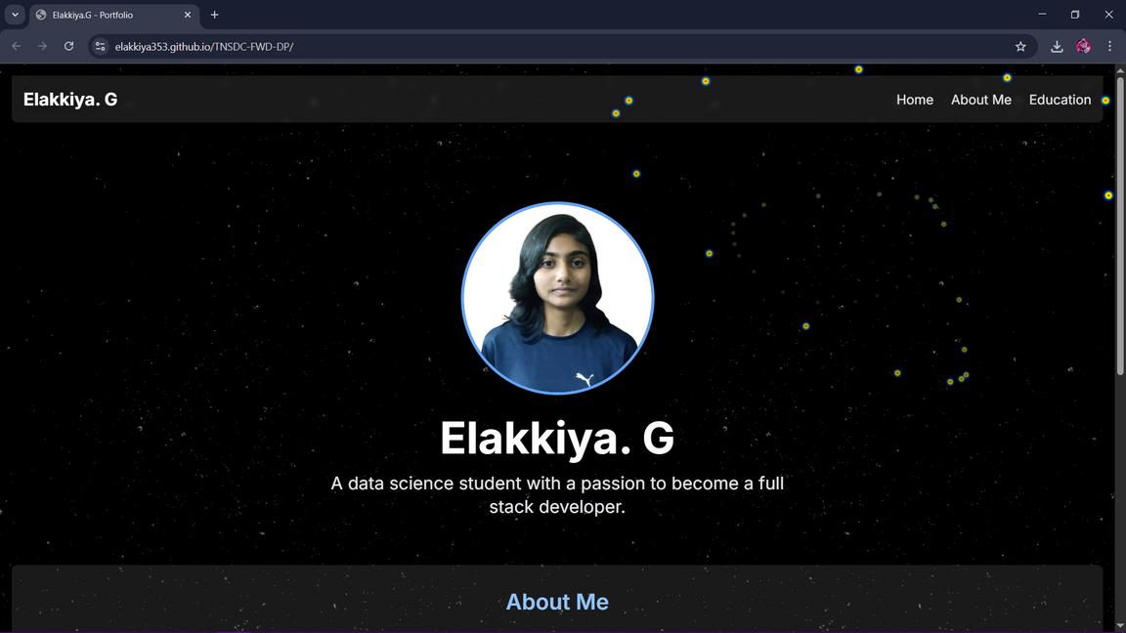
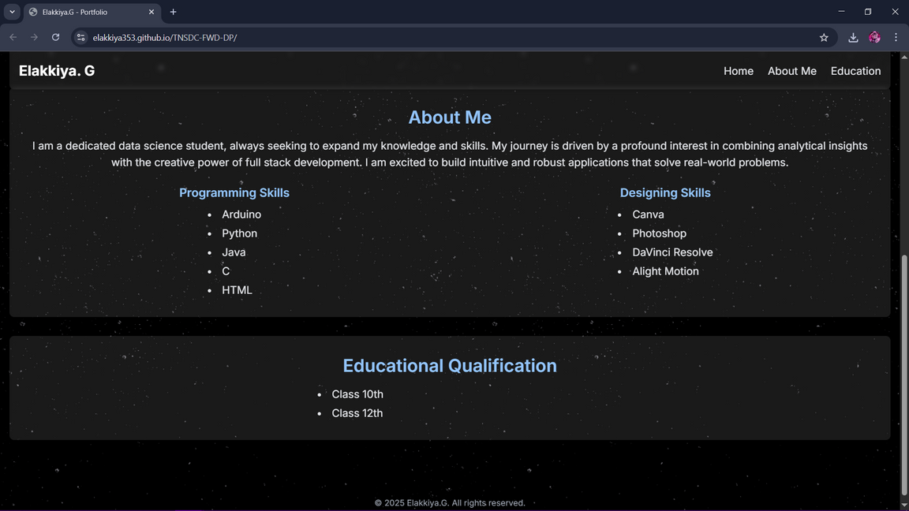
RESULTS AND SCREENSHOTS

Slide 11
CONCLUSION
The portfolio successfully merges academics and creativity.
Provides a professional, personalized online identity.
Enhances opportunities for internships, jobs, and collaborations.
Demonstrates both data science learning and creative design skills.

Slide 12
GITHUB LINK

